Slide 1
DOT NET FRAMEWORK

Slide 2
.NET is a framework to develop software applications.
It is designed and developed by Microsoft and the first beta version released in 2000.
It is used to develop applications for web, Windows, phone.
.NET programs are executed in CLR

Slide 3
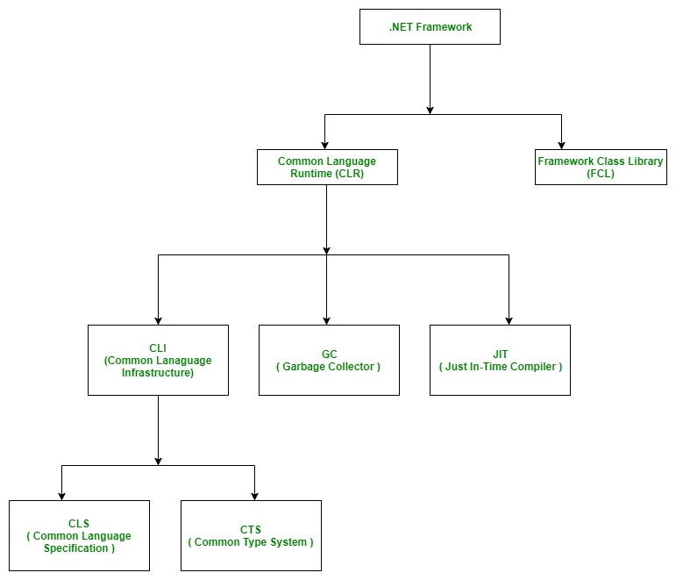

Slide 4
There is a variety of programming languages available on the .Net platform, VB.Net and C# being the most common ones .
1. CLR (Common Language Runtime) : It is a run-time environment which executes the code written in any .NET programming language. .Net framework provides the support for many languages like C#, F#, C++, Cobra, Jscript.Net, VB.Net, Oxygene etc
2. FCL (Framework Class Library) : A large number of class libraries are present in this framework which is known as FCL

Slide 5
3. Types of Applications : Mainly the applications which are built in .Net framework is divided into the following three categories :
WINFORMS
ASP.NET
ADO.NET

Slide 6
.NET Framework Class Library is the collection of classes, namespaces, interfaces and value types that are used for .NET applications.
It contains thousands of classes that supports the following functions.
Base and user-defined data types
Support for exceptions handling
input/output and stream operations
Communications with the underlying system
Access to data
Ability to create Windows-based GUI applications
Ability to create web-client and server applications
Support for creating web services

Slide 7
Net Framework Design Principle:
Interoperability
Portability
Security
Memory management
Simplified deployment

Slide 8
C SHARP
It was developed by Microsoft led by Anders Hejlsberg and his team within the .NET initiative and was approved by the European Computer Manufacturers Association (ECMA) and International Standards Organization (ISO).

Slide 9
C# is object oriented programming language. It provides a lot of features that are given below.
Simple
Modern programming language
Object oriented
Type safe
Interoperability
Scalable and Updateable
Component oriented
Structured programming language

Slide 10

Thank you

